Slide 1

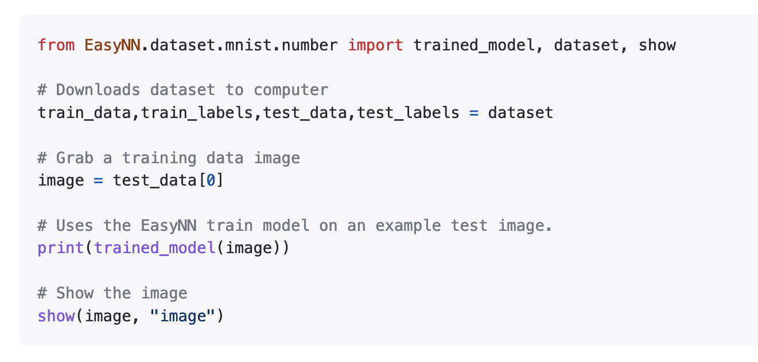
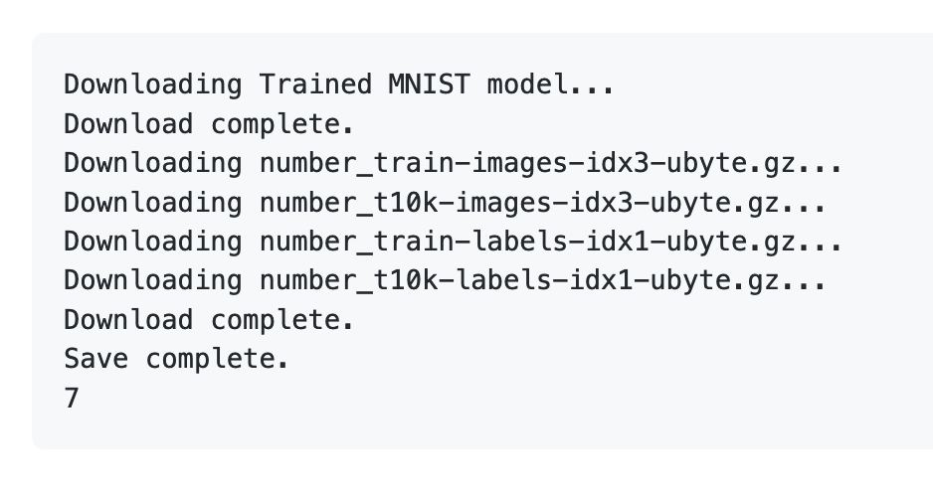
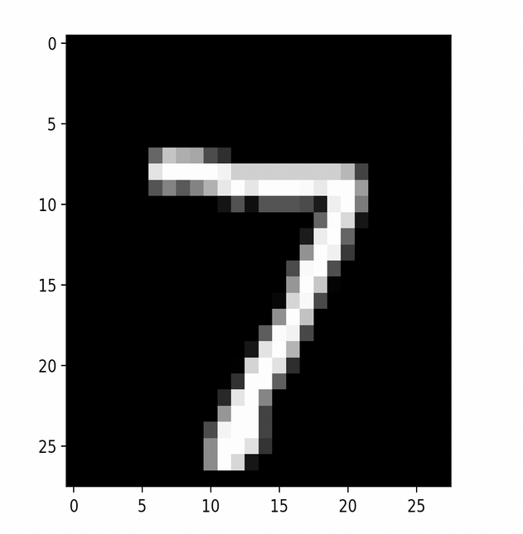
How Easy?
Output:
Dan Wilczak
Jack Nguyen
Liam Kehoe
Nathan Foster
Notes:
Dan

Slide 2
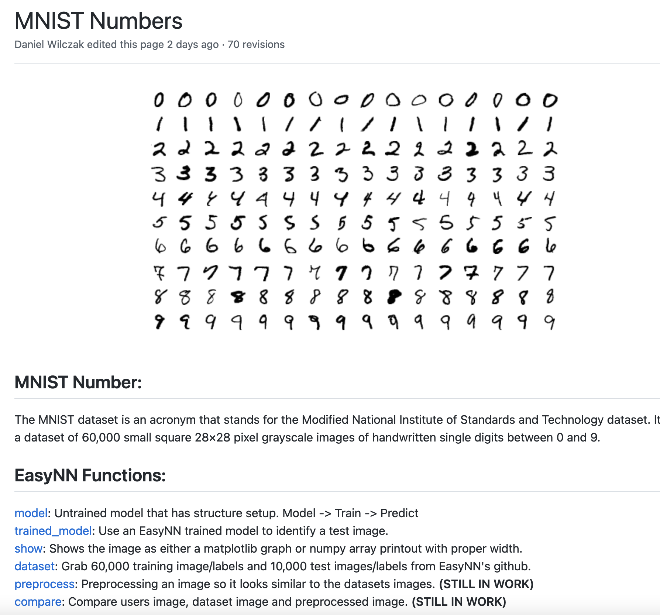
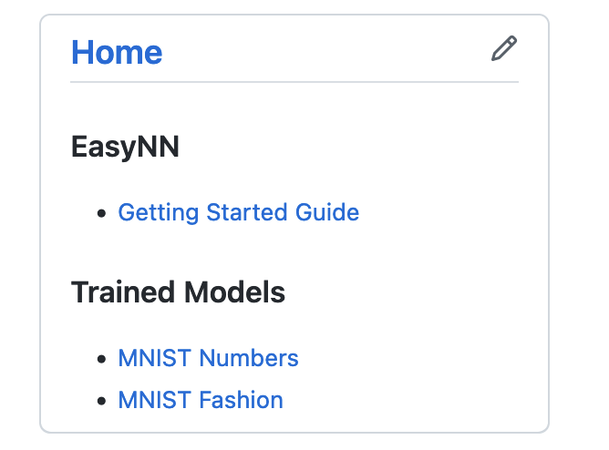
Documentation
is key.
Try it: pip3 install EasyNN
Requires: Python version >= 3.9.7
Documentation makes our software SO easy:
Notes:
Dan

Slide 3
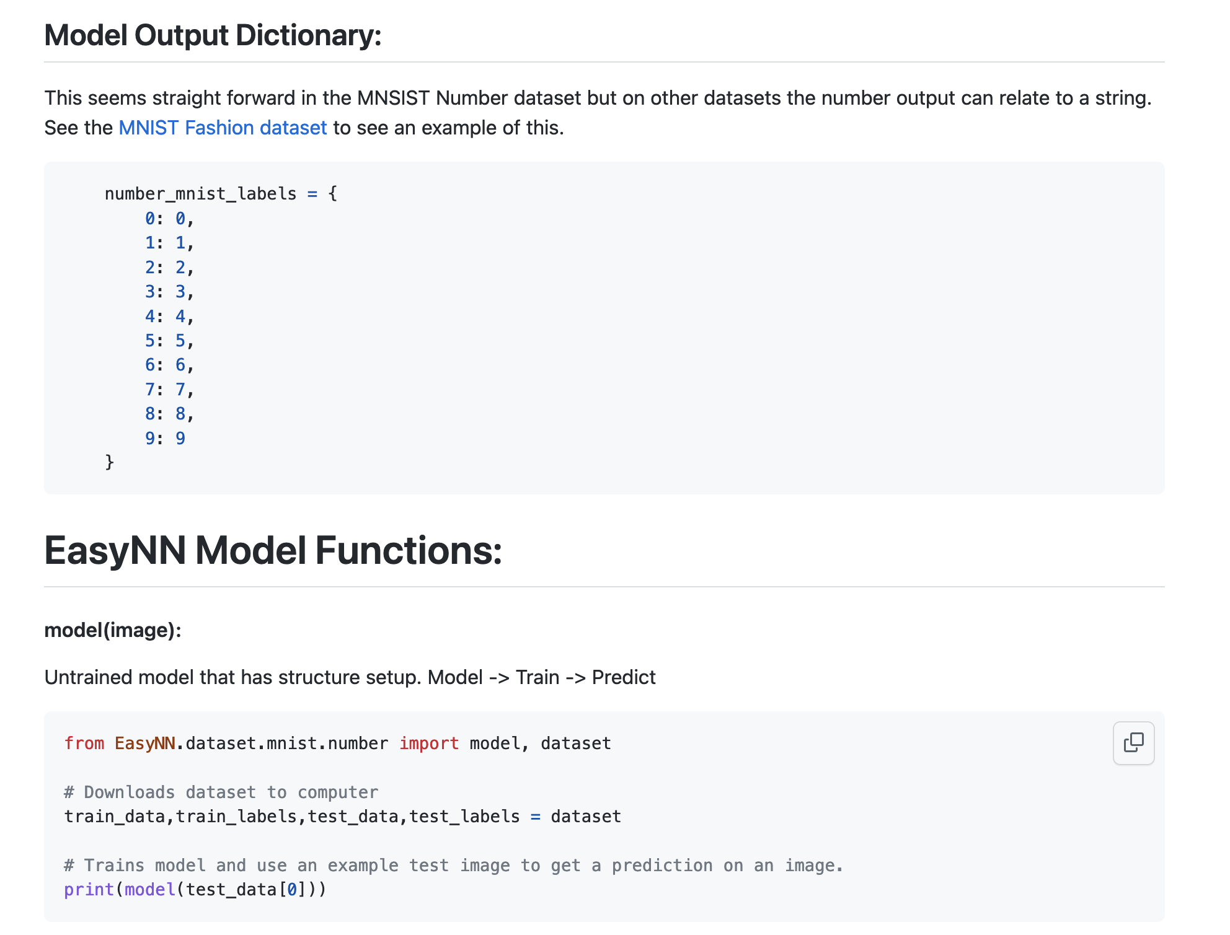
Documentation
is key.
Try it: pip3 install EasyNN
Requires: Python version >= 3.9.7
Documentation makes your software easy:
Notes:
Dan

Slide 4
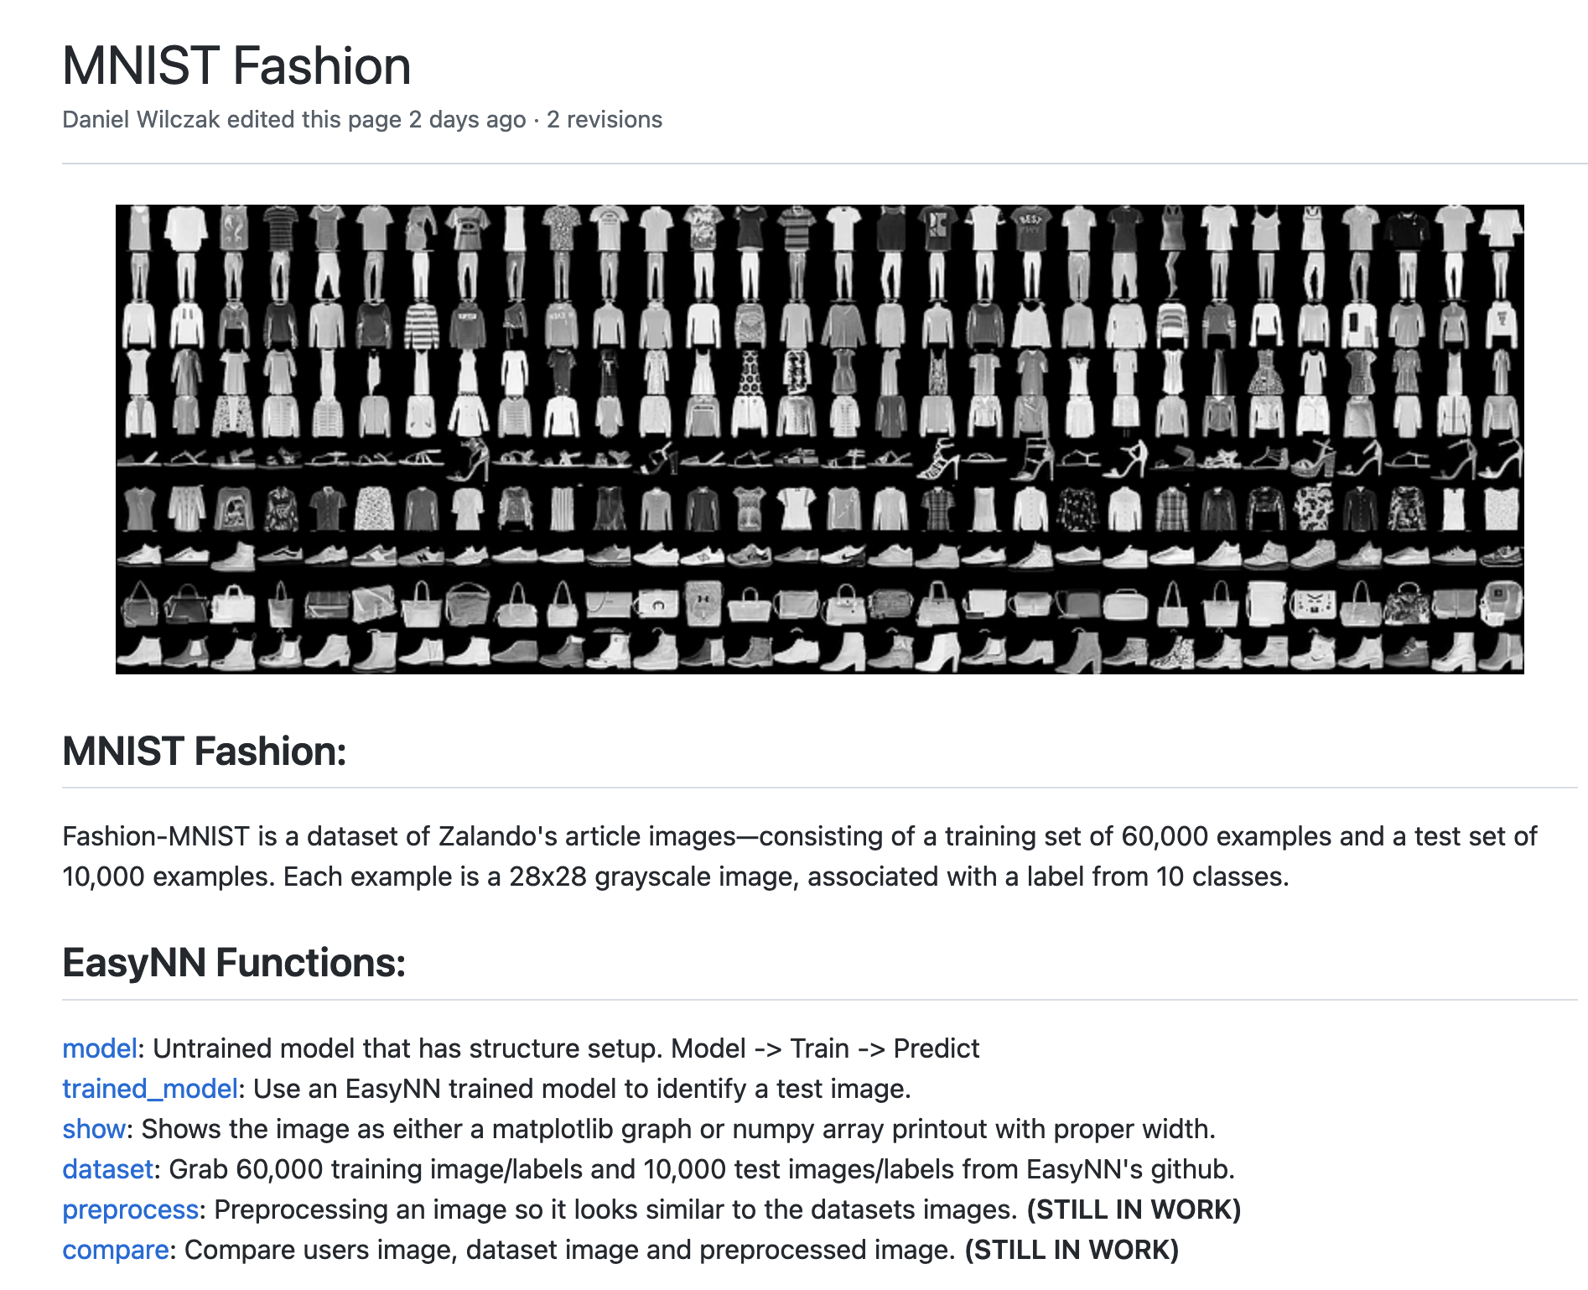
Documentation
is key.
Try it: pip3 install EasyNN
Requires: Python version >= 3.9.7
Documentation makes your software easy:
Notes:
Dan

Slide 5
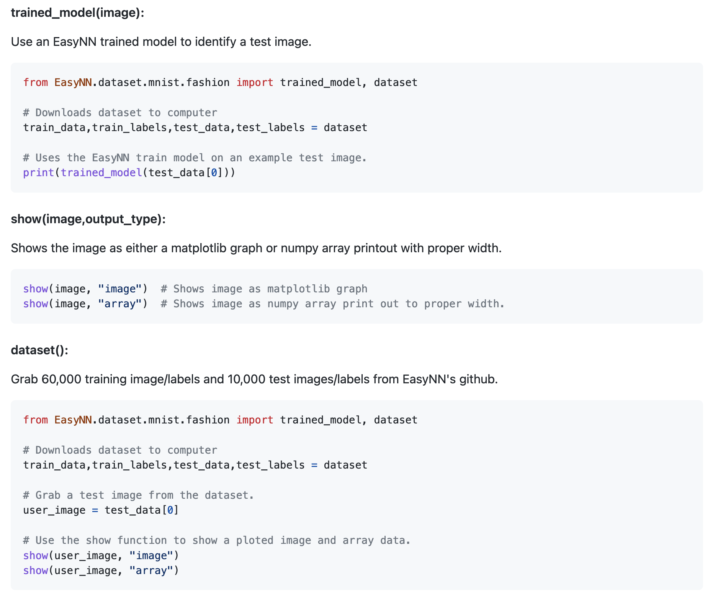
Documentation
is key.
Try it: pip3 install EasyNN
Requires: Python version >= 3.9.7
Documentation makes your software easy:
Notes:
Dan

Slide 6
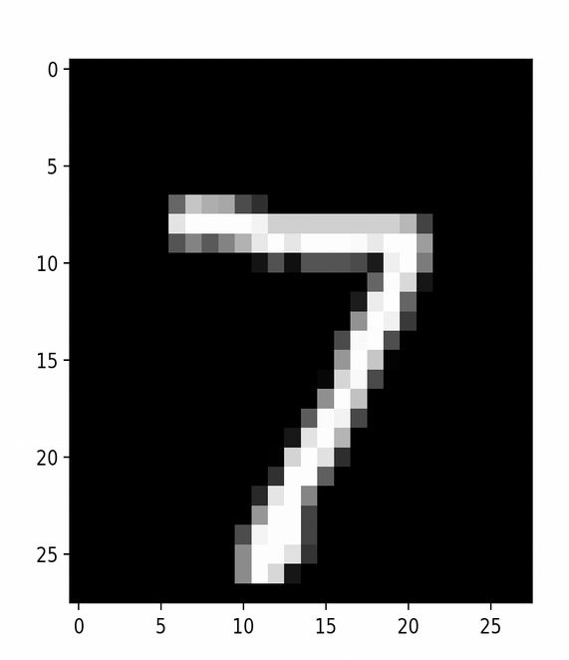
User input Considerations
Images: We assume very little of the users knowledge
of how images in the dataset work or even their own images.
Showing: Images can be shown as typical image or
by seeing the data in the background as a numpy array.
User Success:
User success will be critical on whether or not a user can easily access
and display the data they are using.
[ 0 0 0 0 0 0 0 0 0 0 0 0 0 0 0 0 0 0 0 0 0 0 0 0 0 0 0 0
0 0 0 0 0 0 0 0 0 0 0 0 0 0 0 0 0 0 0 0 0 0 0 0 0 0 0 0
0 0 0 0 0 0 0 0 0 0 0 0 0 0 0 0 0 0 0 0 0 0 0 0 0 0 0 0
0 0 0 0 0 0 0 0 0 0 0 0 0 0 0 0 0 0 0 0 0 0 0 0 0 0 0 0
0 0 0 0 0 0 0 0 0 0 0 0 0 0 0 0 0 0 0 0 0 0 0 0 0 0 0 0
0 0 0 0 0 0 0 0 0 0 0 0 0 0 0 0 0 0 0 0 0 0 0 0 0 0 0 0
0 0 0 0 0 0 0 0 0 0 0 0 0 0 0 0 0 0 0 0 0 0 0 0 0 0 0 0
0 0 0 0 0 0 84 185 159 151 60 36 0 0 0 0 0 0 0 0 0 0 0 0 0 0 0
0 0 0 0 0 0 222 254 254 254 254 241 198 198 198 198 198 198 198 198 170 52
0 0 0 0 0 0 67 114 72 114 163 227 254 225 254 254 254 250 229 254 254 140
0 0 0 0 0 0 0 0 0 0 0 17 66 14 67 67 67 59 21 236 254 106 0 0 0 0
0 0 0 0 0 0 0 0 0 0 0 0 0 0 0 0 0 0 83 253 209 18 0 0 0 0 0 0
0 0 0 0 0 0 0 0 0 0 0 0 0 0 0 0 0 22 233 255 83 0 0 0 0 0 0 0
0 0 0 0 0 0 0 0 0 0 0 0 0 0 0 0 0 129 254 238 44 0 0 0 0 0 0 0
0 0 0 0 0 0 0 0 0 0 0 0 0 0 0 0 59 249 254 62 0 0 0 0 0 0 0 0
0 0 0 0 0 0 0 0 0 0 0 0 0 0 0 0 133 254 187 5 0 0 0 0 0 0 0 0
0 0 0 0 0 0 0 0 0 0 0 0 0 0 0 9 205 248 58 0 0 0 0 0 0 0 0 0
0 0 0 0 0 0 0 0 0 0 0 0 0 0 0 126 254 182 0 0 0 0 0 0 0 0 0 0
0 0 0 0 0 0 0 0 0 0 0 0 0 0 75 251 240 57 0 0 0 0 0 0 0 0 0 0
0 0 0 0 0 0 0 0 0 0 0 0 0 19 221 254 166 0 0 0 0 0 0 0 0 0 0 0
0 0 0 0 0 0 0 0 0 0 0 0 3 203 254 219 35 0 0 0 0 0 0 0 0 0 0 0
0 0 0 0 0 0 0 0 0 0 0 0 38 254 254 77 0 0 0 0 0 0 0 0 0 0 0 0
0 0 0 0 0 0 0 0 0 0 0 31 224 254 115 1 0 0 0 0 0 0 0 0 0 0 0 0
0 0 0 0 0 0 0 0 0 0 0 133 254 254 52 0 0 0 0 0 0 0 0 0 0 0 0 0
0 0 0 0 0 0 0 0 0 0 61 242 254 254 52 0 0 0 0 0 0 0 0 0 0 0 0 0
0 0 0 0 0 0 0 0 0 0 121 254 254 219 40 0 0 0 0 0 0 0 0 0 0 0 0 0
0 0 0 0 0 0 0 0 0 0 121 254 207 18 0 0 0 0 0 0 0 0 0 0 0 0 0 0
0 0 0 0 0 0 0 0 0 0 0 0 0 0 0 0 0 0 0 0 0 0 0 0 0 0 0 0]
Notes:
Dan

Slide 7
Design Considerations
Assumptions: We assume very little. The user
should know basic Python syntax.
Dependencies: Numpy, Matplotlib, PIL
- Handled by pip install
General Constraints/ Core Values:
All users will understand.
All users can use.
(No fancy GPU acceleration).
(No big dependencies i.e Keras, Open CV etc)
Industrial Standards Followed:
Python PEP 8 formatting standards.
Following Google/Numpy in code documentation standards.
Notes:
Liam

Slide 8
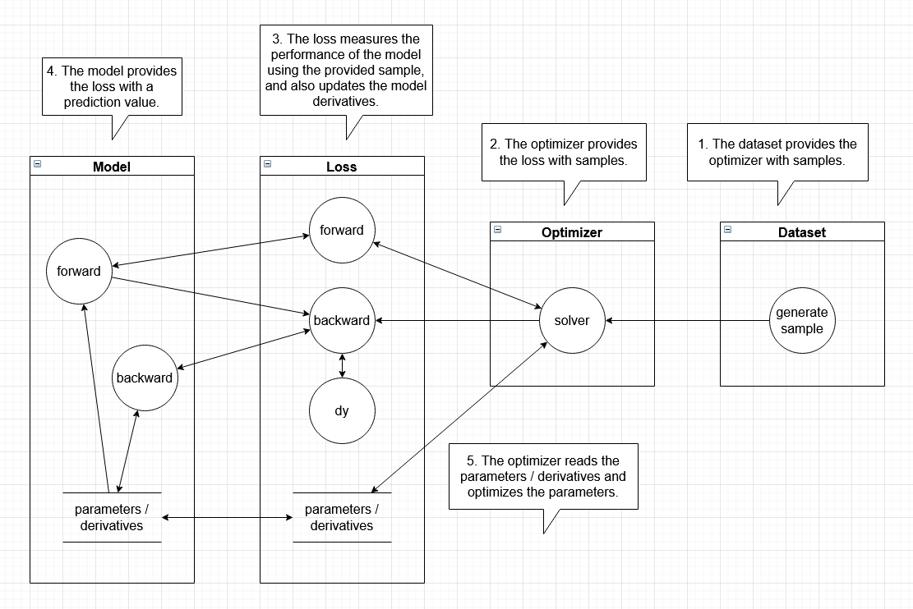
System Architecture
Notes:
Jack

Slide 9
Sub-System Design
The class diagram is currently a work in progress,
but it is partially laid out by the file structure.
The main interactions between classes are shown
on the data flow diagram.
├── loss
│ │ ├── __init__.py
│ │ ├── cross_entropy
│ │ │ ├── __init__.py
│ │ │ ├── binary.py
│ │ │ └── categorical.py
│ │ ├── loss.py
│ │ └── mean_error
│ │ ├── __init__.py
│ │ ├── absolute.py
│ │ └── squared.py
│ ├── model
│ │ ├── __init__.py
│ │ ├── activation
│ │ │ ├── __init__.py
│ │ │ ├── linear.py
│ │ │ ├── relu.py
│ │ │ ├── sigmoid.py
│ │ │ └── softmax
│ │ │ ├── __init__.py
│ │ │ ├── loss_categorical_crossentropy.py
│ │ │ └── softmax.py
│ │ ├── layer
│ │ │ ├── __init__.py
│ │ │ ├── dense.py
│ │ │ ├── dropout.py
│ │ │ └── input.py
│ │ └── network.py
│ └── optimizer
│ ├── RMSprop.py
│ ├── SGD.py
│ ├── __init__.py
│ ├── adagrad.py
│ └── adam.py
EasyNN
│ ├── __init__.py
│ ├── accuracy
│ │ ├── __init__.py
│ │ ├── accuracy.py
│ │ ├── categorical.py
│ │ └── regression.py
│ ├── dataset
│ │ ├── __init__.py
│ │ ├── common.py
│ │ └── mnist
│ │ ├── __init__.py
│ │ ├── fashion.py
│ │ ├── fashion_
│ │ │ ├── __init__.py
│ │ │ ├── data
│ │ │ │ └── __init__.py
│ │ │ └── trained_models
│ │ │ └── __init__.py
│ │ ├── number.py
│ │ └── number_
│ │ ├── __init__.py
│ │ ├── data
│ │ │ └── __init__.py
│ │ └── trained_models
│ │ └── __init__.py
Notes:
Jack/Dan

Slide 10
Lessons Learned
Scope reduction from last semester.
Wiki documentation is the key to success for a good user base.
Work together to follow standards.
Neural Networks are hard and take time for people to fully
understand how they work.
Finding a middle ground between:
TensorFlow’s: general complexity for all problems.
Books/Beginner: tutorials lack usability for new problems.
EasyNN bridging the middle ground.
Notes:
Nate

Slide 11
Project Timeline
Sprint 1:
Working NN:
Test version 1 of base code
Datasets:
Number MNIST
Fashion MNIST
CIFAR10
Wiki documentation of datasets and how to use them.
Sprint 2:
Swap to Version 2 of base code
Allow users to create custom structured NN’s
Add Sqlite3 database to record training progress
Add matplotlib support to database data
Add documentation throughout
Sprint 3: Provide examples to users and allow for
saving and loading models from previous executions of
custom model.
Notes:
Nate

Slide 12
Questions?

